Slide 1

Inference on Markov Chains
Subtitle

Slide 2
Stochastic Process
Description of the movement of an object over time
A collection of random variables
X={X_{t} : t∈T}
defined on a common probability space, taking values in a common set S (the state space), and indexed by a set T, often either N or [0,∞) and thought of as time (discrete or continuous respectively)
For example, Bernoulli process

Slide 3
Markov Chain
Sequence of random variables such that for any n, X_{n+1} is conditionally independent of X₀, . . . , X_{n-1} given X_{n}
The stochastic process X = {X_{n} ; n ϵ N} is a Markov Chain when,
P{X_{n+1} = j | X₀, ....., X_{n}} = P{X_{n+1} = j | X_{n}}
∀ j ϵ E and n ϵ N = {0,1,2,3,….}
where, E is a countable set

Slide 4
Markov Chain (Cont.)
The “next” state X_{n+1} of the process is independent of the “past” states X₀, . . . , X_{n-1} provided that the “present” state X_{n} be known.
P{X_{n+1} = j | X_{n} = i} = P(i,j) i,j ϵ E
For example, number of successes (N_{n}) in a Bernoulli process

Slide 5


Transition matrix of Markov chain
P =
P =
P is said to be the Markov Matrix over E when,
For any i,j ϵ E, P(i,j) ≥ 0
For each i ϵ E,
(To be removed??)

Slide 6
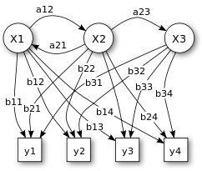
Hidden Markov Model (HMM)
A statistical Markov model in which the system being modeled is assumed to be a Markov process with unobserved (hidden) states
Can be presented using a simple
dynamic Bayesian network
X — states (hidden, to be inferred) y — observations a_{ij} — state transition probabilities (probability of
transition from state i to state j) b_{i}(y_{t}) — emission probabilities (probability of an
observation y_{t} being generated from a state i)

Slide 7
Hidden Markov Model (Cont.)
Assumptions:
The probability of a particular state depends only on the previous state.
Markov Assumption:
P{X_{i} | X₁, ....., X_{i-1}} = P{X_{i} | X_{i-1}}
The probability of an output observation y_{t} depends only on the state (X_{i}) that produced the observation and not on any other states or any other observations.
Output Independence:
P{y_{t} | X₁, X₂, .., X_{i}, .., X_{T}, y₁, y₂, .., y_{t}, .., y_{T}} = P{y_{t} | X_{i}}

Slide 8
Algorithms associated with HMM
Forward Algorithm (Likelihood):
Given an HMM λ= (A, B) and an observation sequence Y, the likelihood P(Y | λ) is determined.
Viterbi Algorithm (Decoding):
Given an observation sequence Y and an HMM λ= (A, B), the best hidden state sequence X is discovered.
Baum-Welch (Learning):
Given an observation sequence Y and the set of states in the HMM, the HMM parameters A and B are learned.

Slide 9
Viterbi Algorithm
Determining which sequence of variables is the underlying source of some sequence of decoding observations
Most common decoding algorithm for HMM
Dynamic programming algorithm that makes uses of a dynamic programming trellis

Slide 10
Viterbi Algorithm (Cont.)
For a given state x_{j} at time t, the value v_{t}(j) is computed as,
v_{t}(j) =
v_{t-1}(i) is the previous Viterbi path probability from the previous time step
a_{ij} is the transition probability from previous state x_{i} to current state x_{j}
b_{j}(y_{t}) is the state observation likelihood of the observation symbol y_{t}
given the current state j

Slide 11
Example
Consider a village where all villagers are either “healthy” or have a “fever” and only the village doctor can determine whether each has a fever. The doctor diagnoses fever by asking patients how they feel. The villagers may only answer that they feel ‘normal’, ‘dizzy’, or ‘cold’.
A patient visits three days in a row and the doctor discovers that on the first day she feels normal, on the second day she feels cold, on the third day she feels dizzy.
What is the most likely sequence of health conditions of the patient that would explain these observations?

Slide 12
Example: HMM
Hidden States: Healthy (H) and Fever (F)
Observations: Normal (N), Cold (C) and Dizzy (D)
Start Probability: The doctor's belief about which state the HMM is in when the patient first visits
Transition Probability: The change of the health condition in the underlying Markov chain
Emission Probability: How likely the patient is to feel on each day

Slide 13
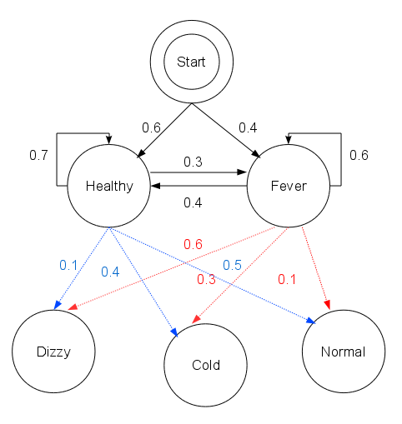
Example: HMM (Cont.)
Graphical Representation for the given HMM

Slide 14
Example: Trellis Structure
H
Probability of the person being Healthy on Day 1
= 1 X 0.3 = 0.3
0.6 X 0.5 = 0.3
P(H|Start)*P(N|H)
START
P(F|Start)*P(F|N)
0.4 X 0.1 = 0.04
F
Probability of the person having Fever on Day 1
= 1 X 0.04 = 0.04
Day 1 Observation: Person is feeling “Normal”

Slide 15
Example: Trellis Structure (Cont.)
H
0.7 X 0.4 = 0.28
H
Probability of the person being
Healthy on Day 2
= max(0.3*0.28, 0.04*0.16)
= max(0.084, 0.0064)
= 0.084
P(H|H)*P(C|H)
0.3
0.3
0.3 X 0.3 = 0.09
P(F|H)*P(C|F)
START
0.4 X 0.4 = 0.16
Probability of the having Fever
on Day 2
= max(0.3*0.09, 0.04*0.18)
= max(0.027, 0.0072)
= 0.027
P(H|F)*P(C|H)
0.04
0.04
F
P(F|F)*P(C|F)
F
0.6 X 0.3 = 0.18
Day 2 Observation: Person is feeling “Cold”

Slide 16
Example: Trellis Structure (Cont.)
H
0.28
H
Probability of the person being
Healthy on Day 2
= max(0.3*0.28, 0.04*0.16)
= max(0.084, 0.0064)
= 0.084
0.3
0.3
0.084
START
0.09
Probability of the having Fever
on Day 2
= max(0.3*0.09, 0.04*0.18)
= max(0.027, 0.0072)
= 0.027
0.04
0.027
F
F
Day 2 Observation: Person is feeling “Cold”

Slide 17
Example: Trellis Structure (Cont.)
0.28
0.7 X 0.1 = 0.07
H
H
H
P(H|H)*P(D|H)
0.3
0.3
0.084
0.3 X 0.6 = 0.18
P(F|H)*P(D|F)
START
0.09
0.4 X 0.1 = 0.04
P(H|F)*P(D|H)
0.04
0.027
F
F
P(F|F)*P(D|F)
F
0.6 X 0.6 = 0.36
Day 3 Observation: Person is feeling “Dizzy”

Slide 18
Example: Trellis Structure (Cont.)
Probability of the person being Healthy on Day 3
= max(0.084*0.07, 0.027*0.04)
= max(0.00588, 0.00108)
= 0.00588
Probability of the having Fever on Day 3
= max(0.084*0.18, 0.027*0.36)
= max(0.01512, 0.00972)
= 0.01512

Slide 19
Example: Trellis Structure (Cont.)
0.28
0.07
H
H
H
0.3
0.3
0.084
0.00588
START
0.18
0.04
0.027
F
F
F
0.01512
Day 3 Observation: Person is feeling “Dizzy”

Slide 20
Example: Trellis Structure (Cont.)
0.28
H
H
H
0.3
0.3
0.084
0.00588
START
0.18
0.04
0.027
F
F
F
0.01512
Day 3 Observation: Person is feeling “Dizzy”

Slide 21
Inference
The process of discovering the sequence of hidden states, given the sequence of observations, is known as decoding or inference

Slide 22
Suggested Readings
Introduction to Stochastic Processes by E. Cinlar
https://en.wikipedia.org/wiki/Hidden_Markov_model
https://en.wikipedia.org/wiki/Viterbi_algorithm
https://web.stanford.edu/~jurafsky/slp3/9.pdf

Slide 23

Thank you!
Subtitle

